Slide 1
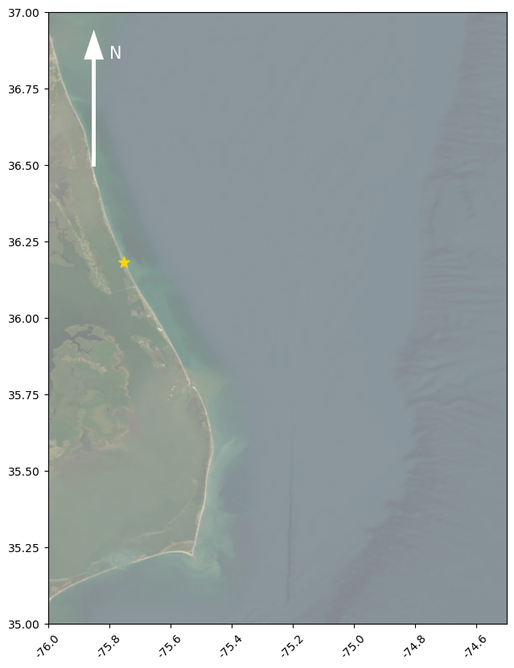
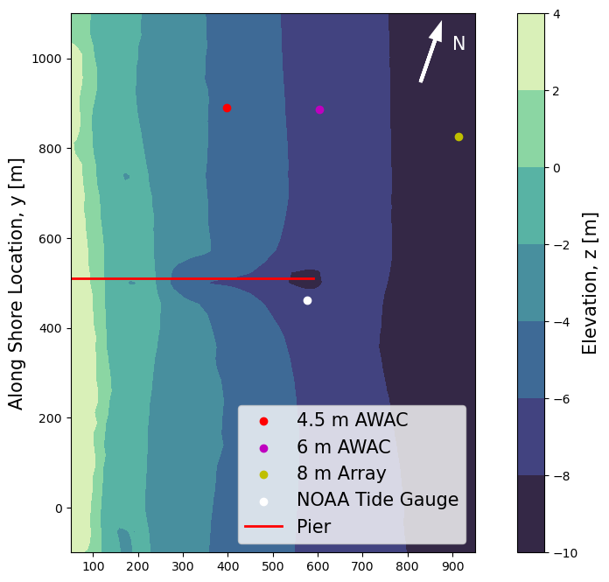
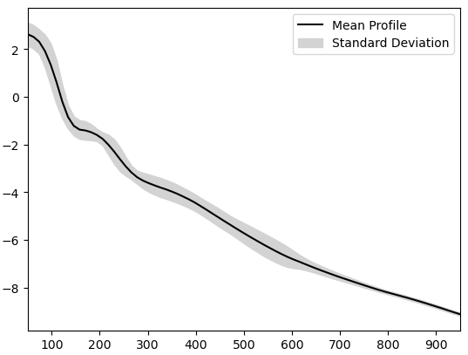
Figure 1 – Location of Field site, fixed instruments and bathymetry
(a)
(b)
Along Shore Location, y [m]
Elevation, z [m]
Latitude [°N]
Cross Shore Location, x [m]
Elevation, z [m]
(c)
Cross Shore Location, x [m]
Longitude [°E]

Slide 2
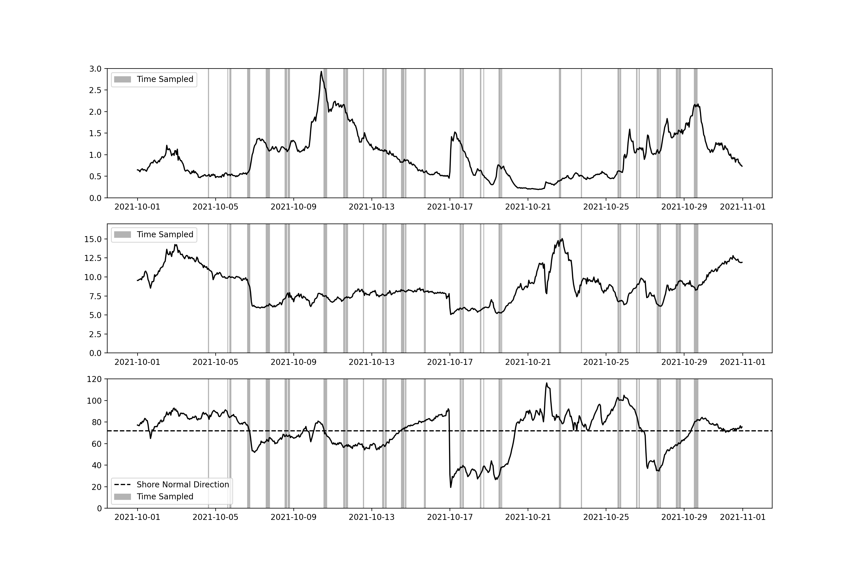
Figure 2 – Conditions sampled during the experiment
(a)
Significant Wave Height [m]
(b)
Mean Wave Period [s]
(c)
Mean Wave Direction [deg from north]
Time [UTC]

Slide 3
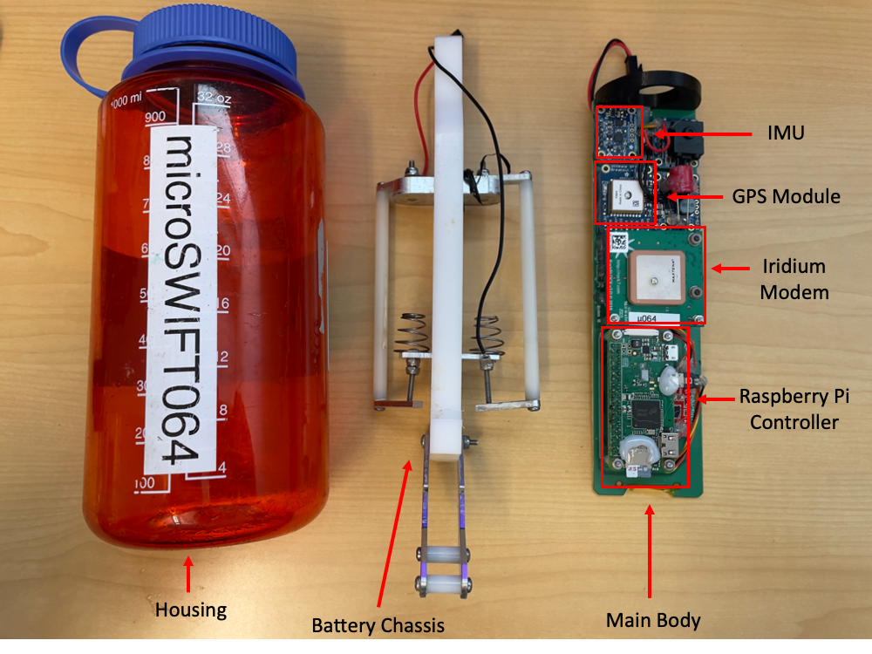
Figure 3 – Layout of microSWIFT

Slide 4
Figure 4 – Recording Software Flow
Main Processing and Control Script
(microSWIFT.py)
Boot up and Start Onboard Logging
Wait for Start of Recording Window
Record IMU Data
Record GPS Data
Onboard Processing of Data
(GPSwaves Algorithm)
Send Processed Data to Server
Notes:
Arrows branching from record IMU data and record GPS data make it look like “either or” instead of “and”. At the end bracket from “send processed data to server”, add arrows on each line connecting it back to “wait for start of recording window”

Slide 5
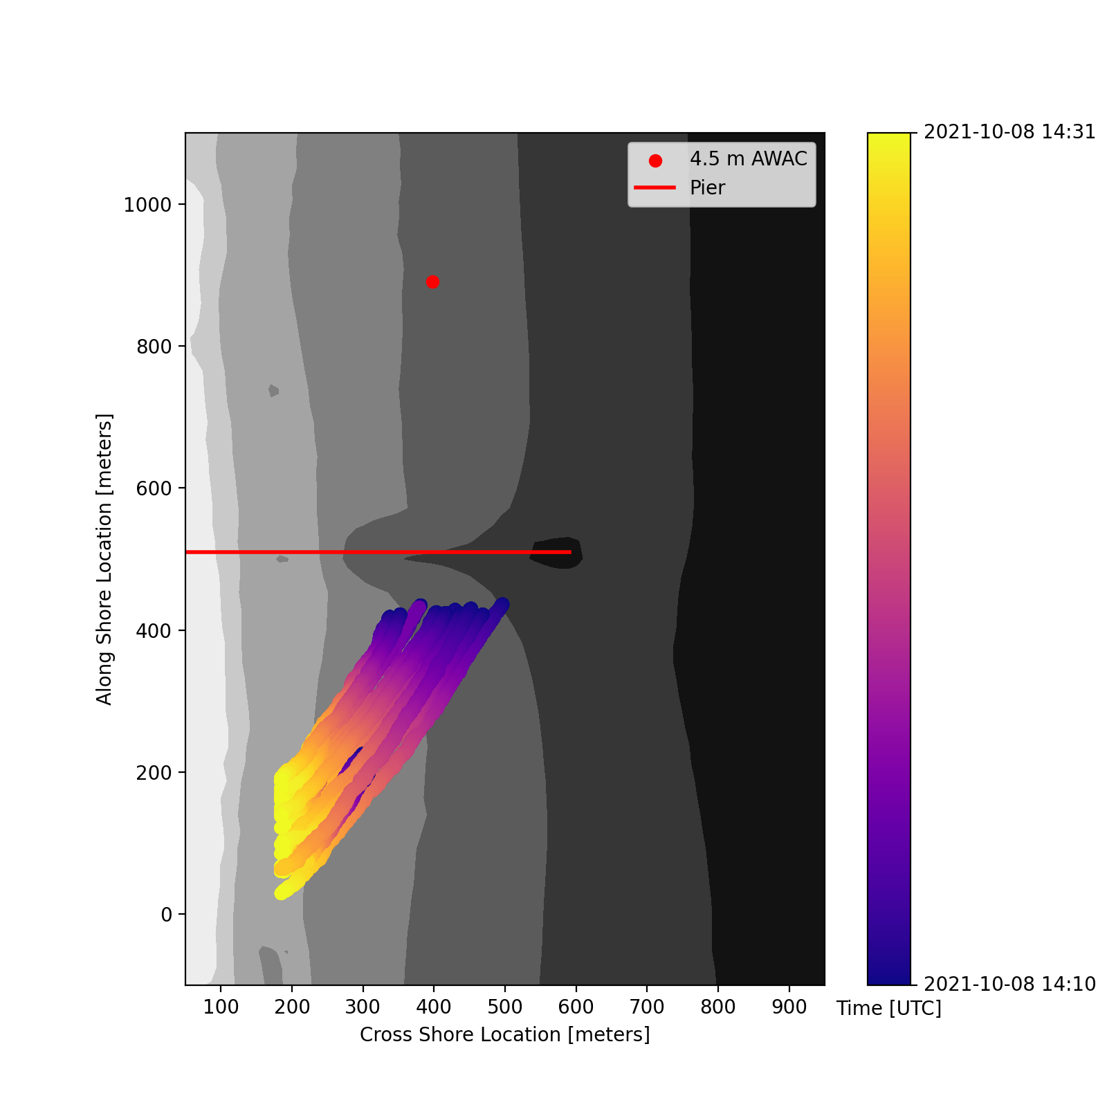
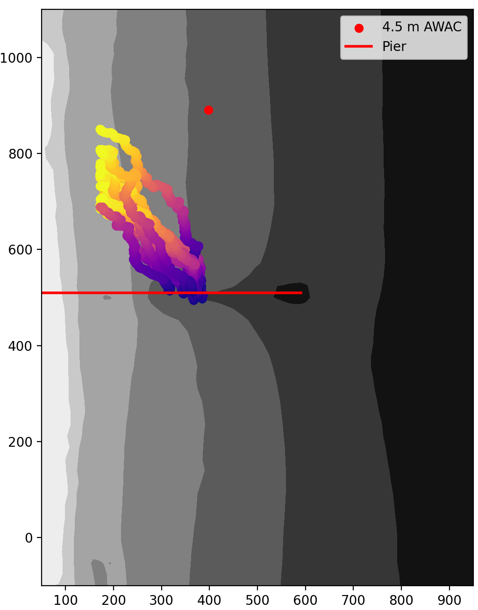
Figure 5 – Example Missions
Time [UTC]
2021-10-29 15:04
Time [UTC]
2021-10-08 14:10
2021-10-08 14:31
2021-10-29 15:11
(a)
(b)
-4 meters
-6 meters
-8 meters
-4 meters
-6 meters
-8 meters
Along Shore Location, y [m]
Along Shore Location, y [m]
Cross Shore Location, x [m]
Cross Shore Location, x [m]
Notes:
Increase size of label for color bar and make units more clear

Slide 6

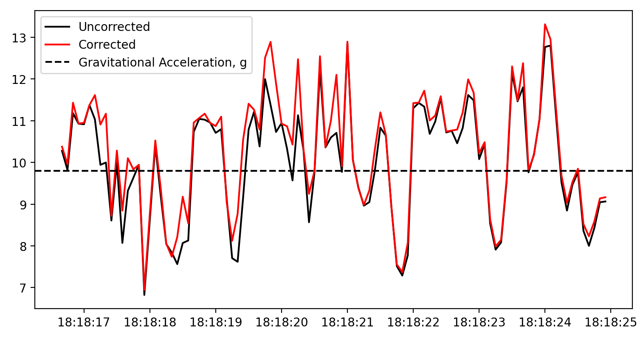
Figure 6 – Processing of Raw Data
(a)
AHRS Estimation and Band-Pass Filtered
g
g
Uncorrected Down
(relative to the buoy)
Corrected Down
(relative to the buoy)
(b)
Vertical Acceleration [m s⁻²]
Time [UTC]

Slide 7
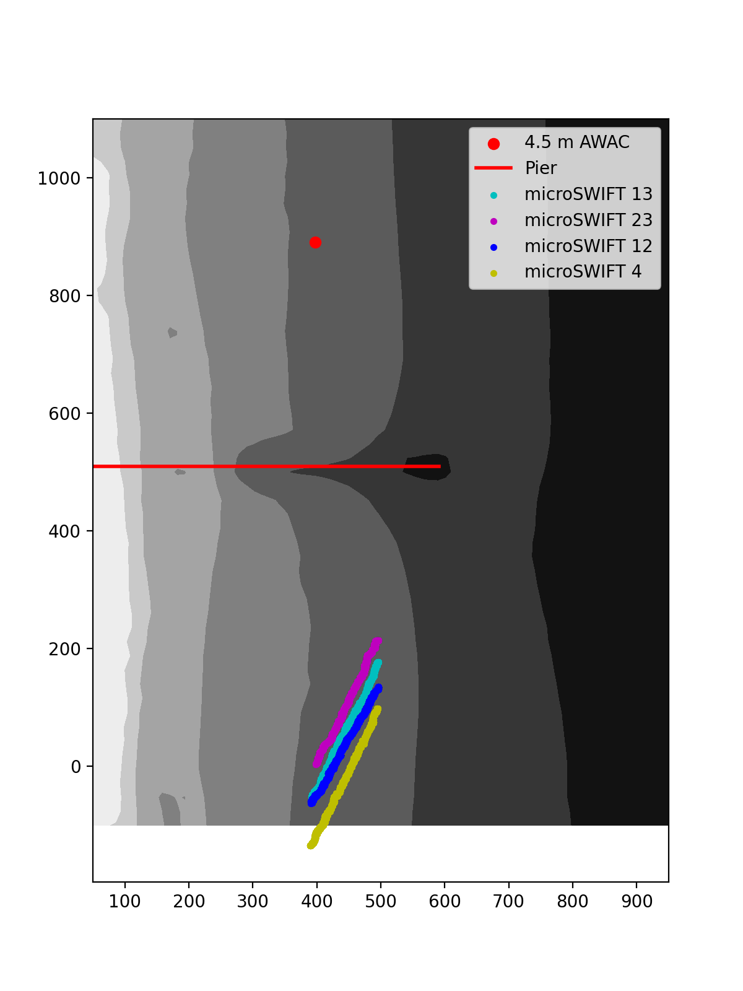
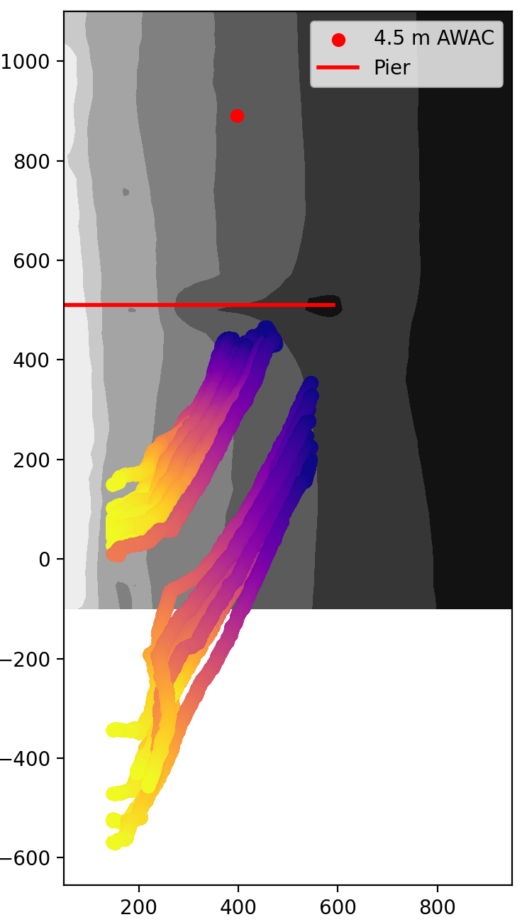
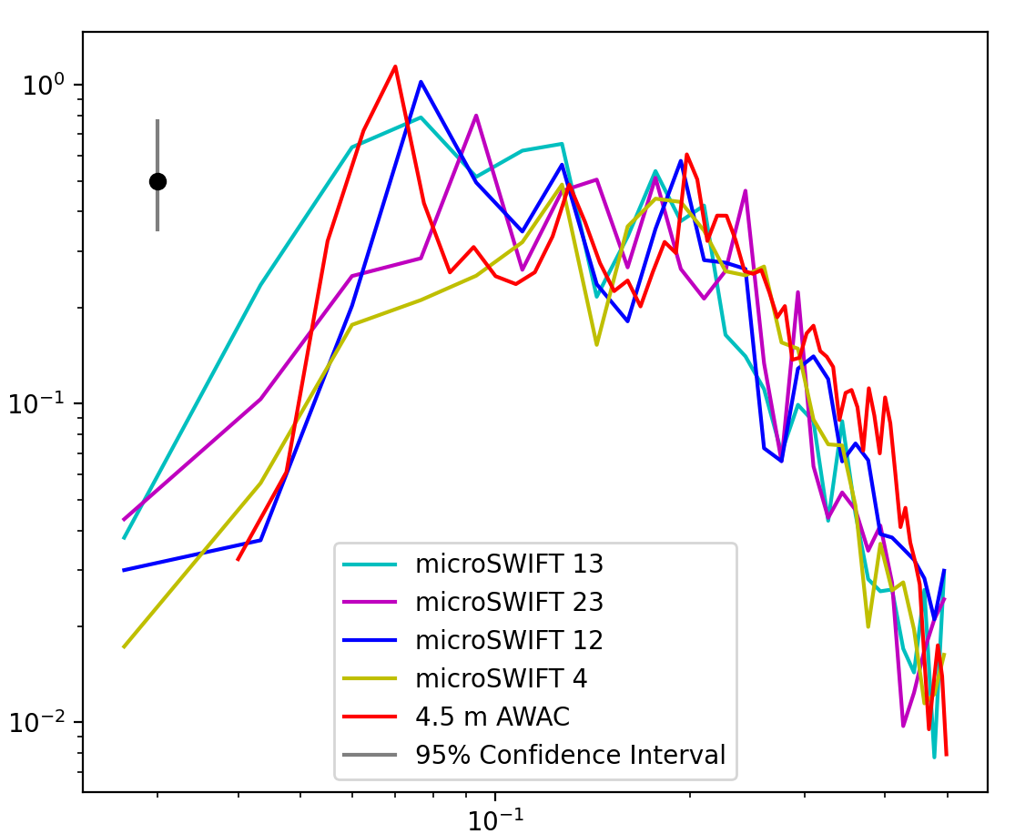
Figure 7 – microSWIFT spectral validation
Time [UTC]
2021-10-08 17:04
2021-10-08 17:41
(a)
(b)
-4 meters
-8 meters
-6 meters
-4 meters
-6 meters
-8 meters
Along Shore Distance [m]
Along Shore Distance [m]
Cross Shore Distance [m]
Cross Shore Distance [m]
(c)
Energy Density [m² Hz⁻¹]
Frequency [Hz]

Slide 8
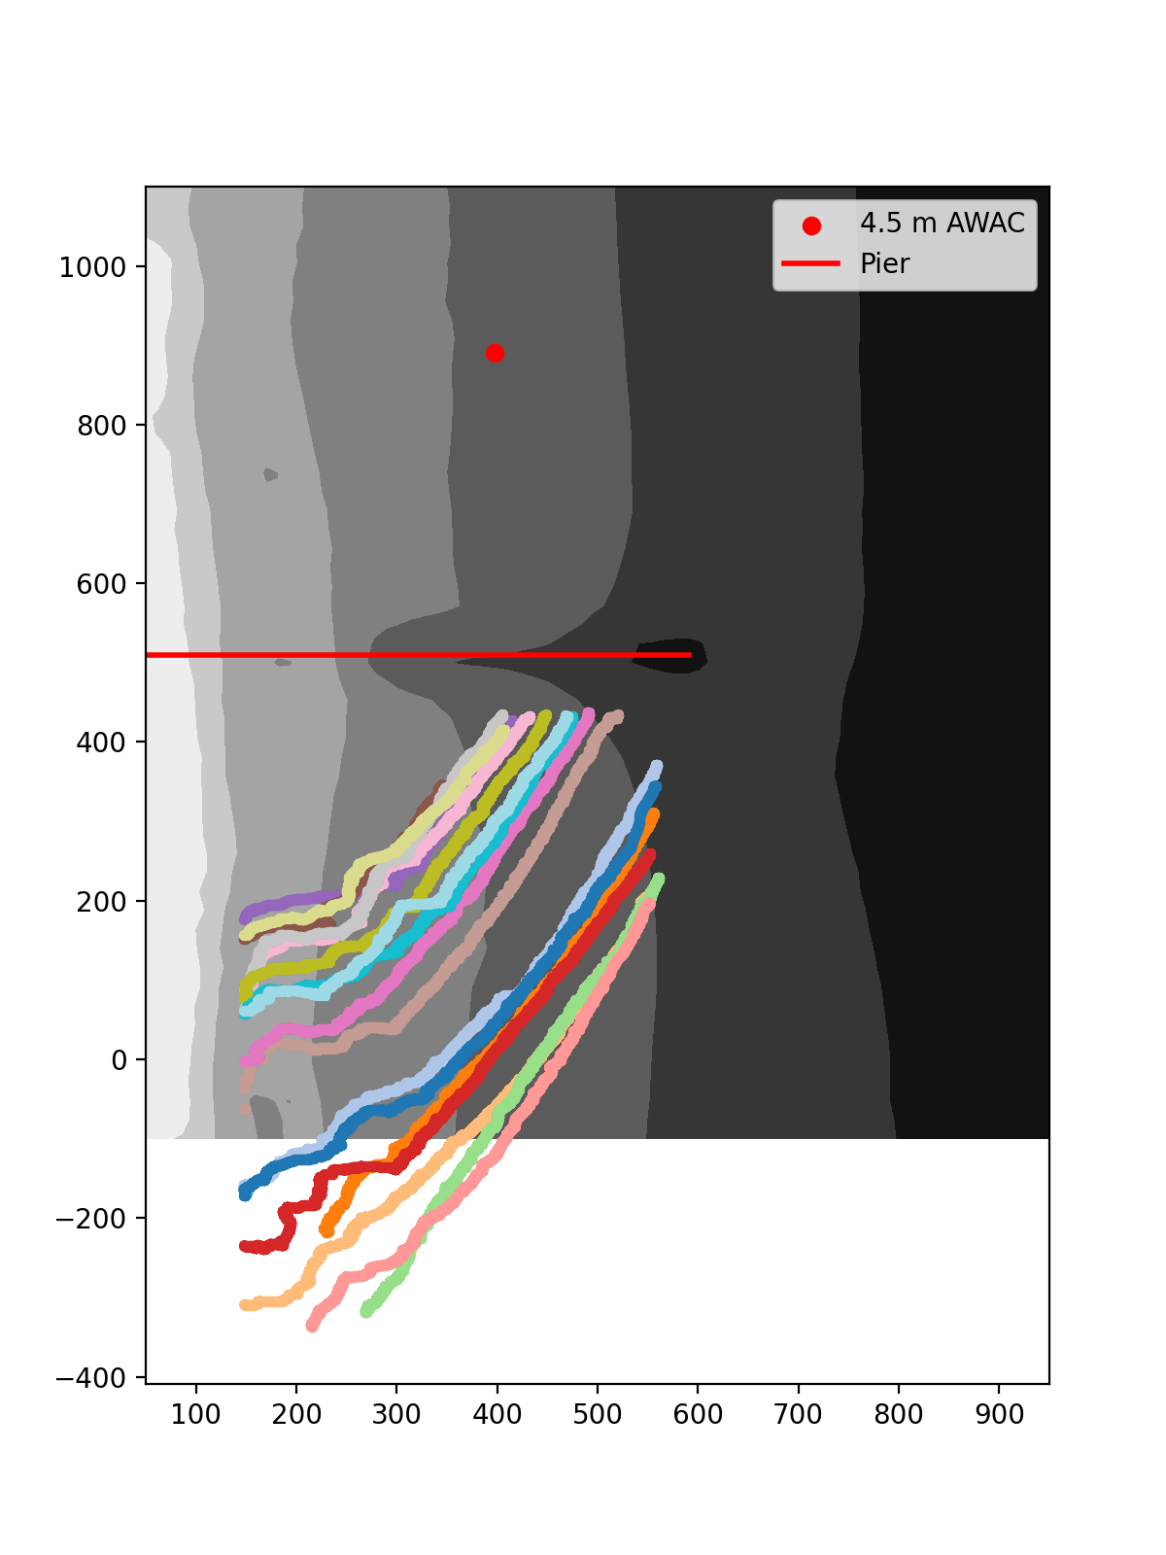
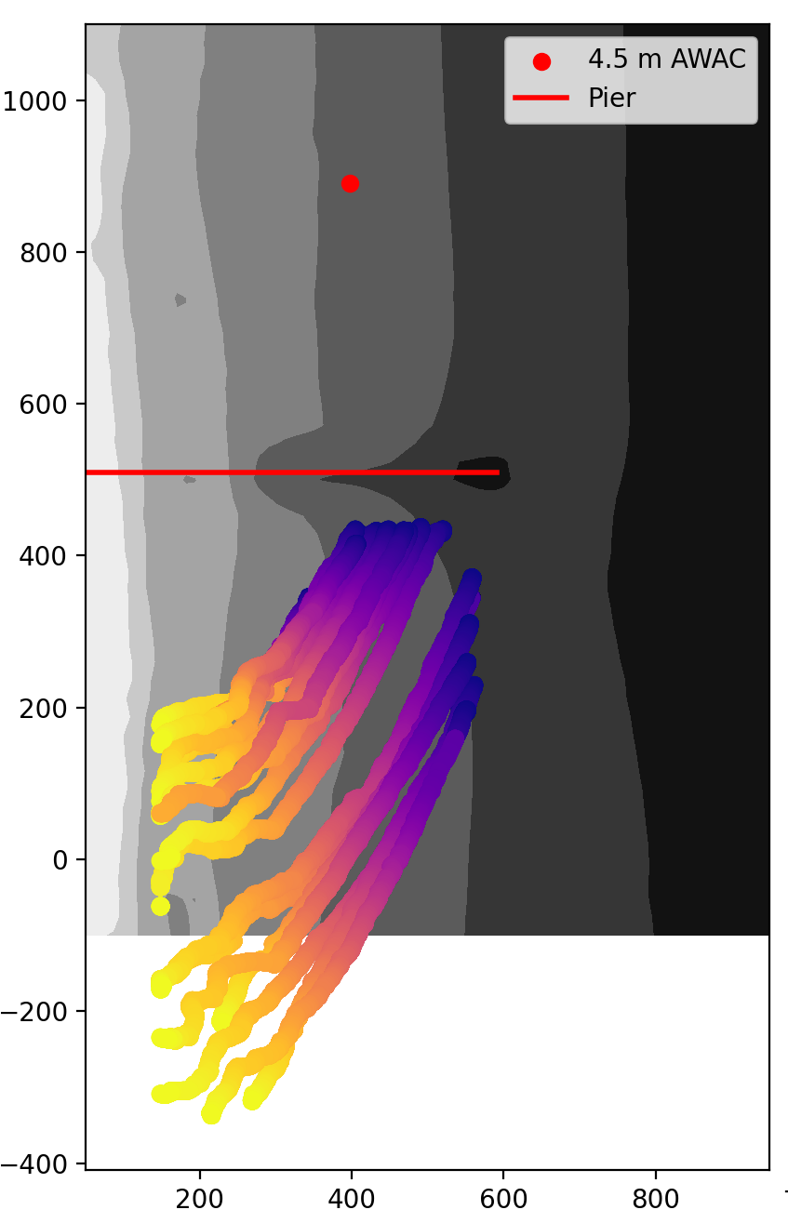
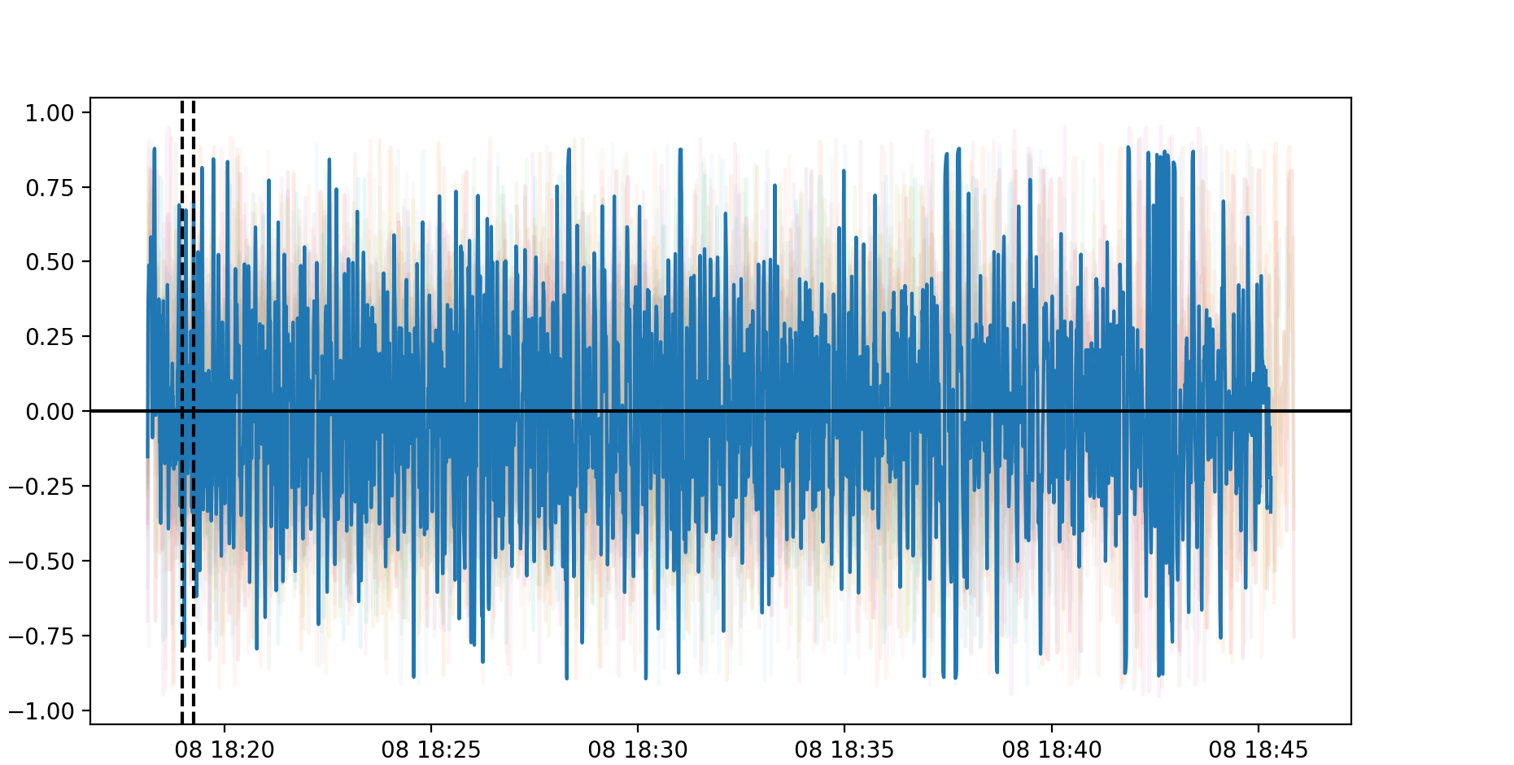
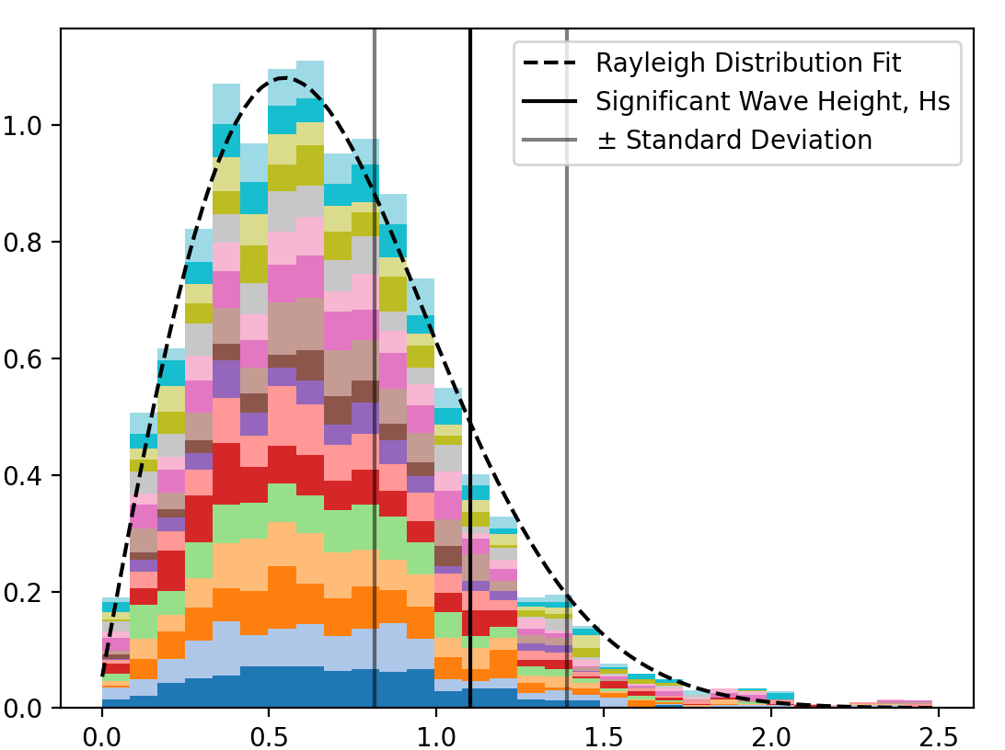
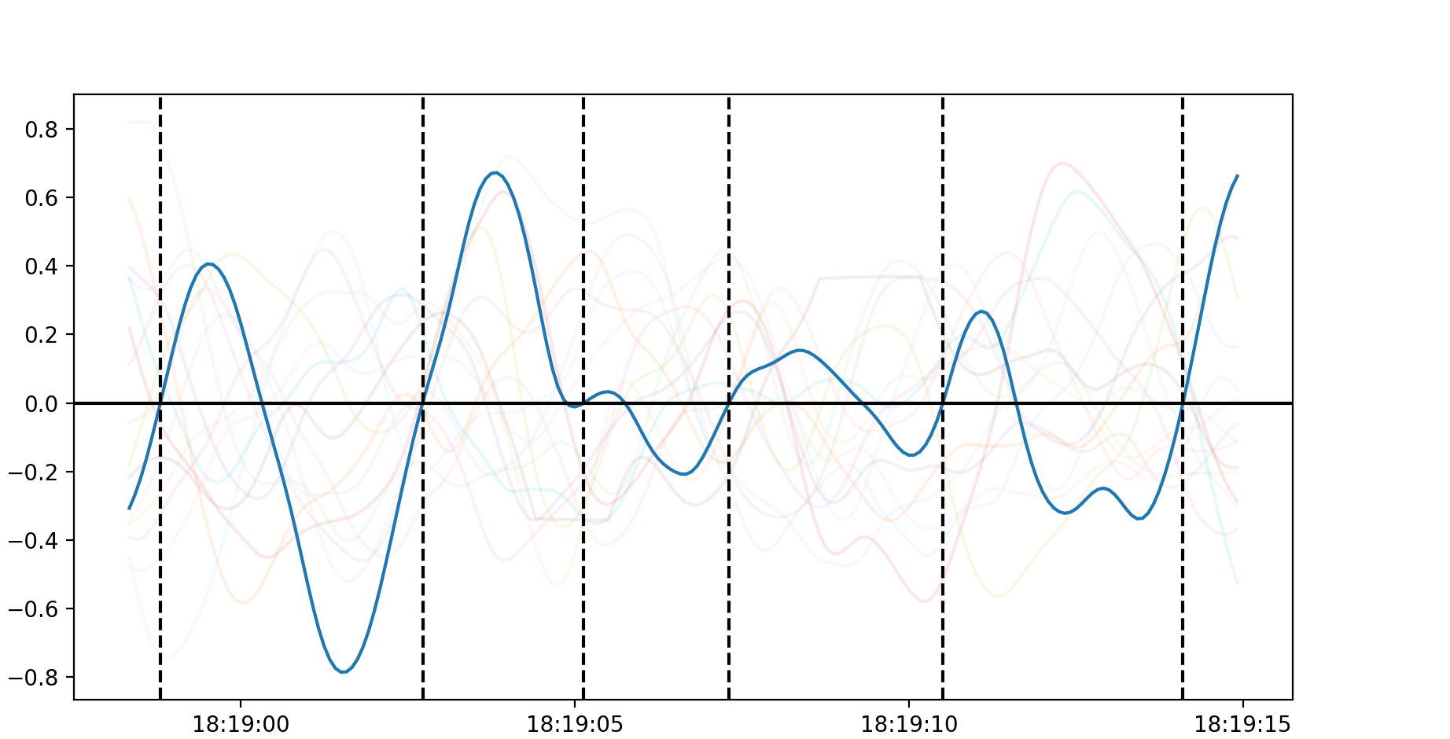
Figure 8 - Mission Processing Steps
Time [UTC]
2021-10-08 18:18
2021-10-08 18:45
(a)
(b)
-4 meters
-8 meters
-4 meters
-6 meters
-8 meters
-6 meters
Along Shore Distance [m]
Along Shore Distance [m]
Cross Shore Distance [m]
Cross Shore Distance [m]
(c)
(e)
Sea Surface Elevation [m]
Time [UTC]
Probability Density
(d)
H
Sea Surface Elevation [m]
Wave Height, H [m]
Time [UTC]

Slide 9
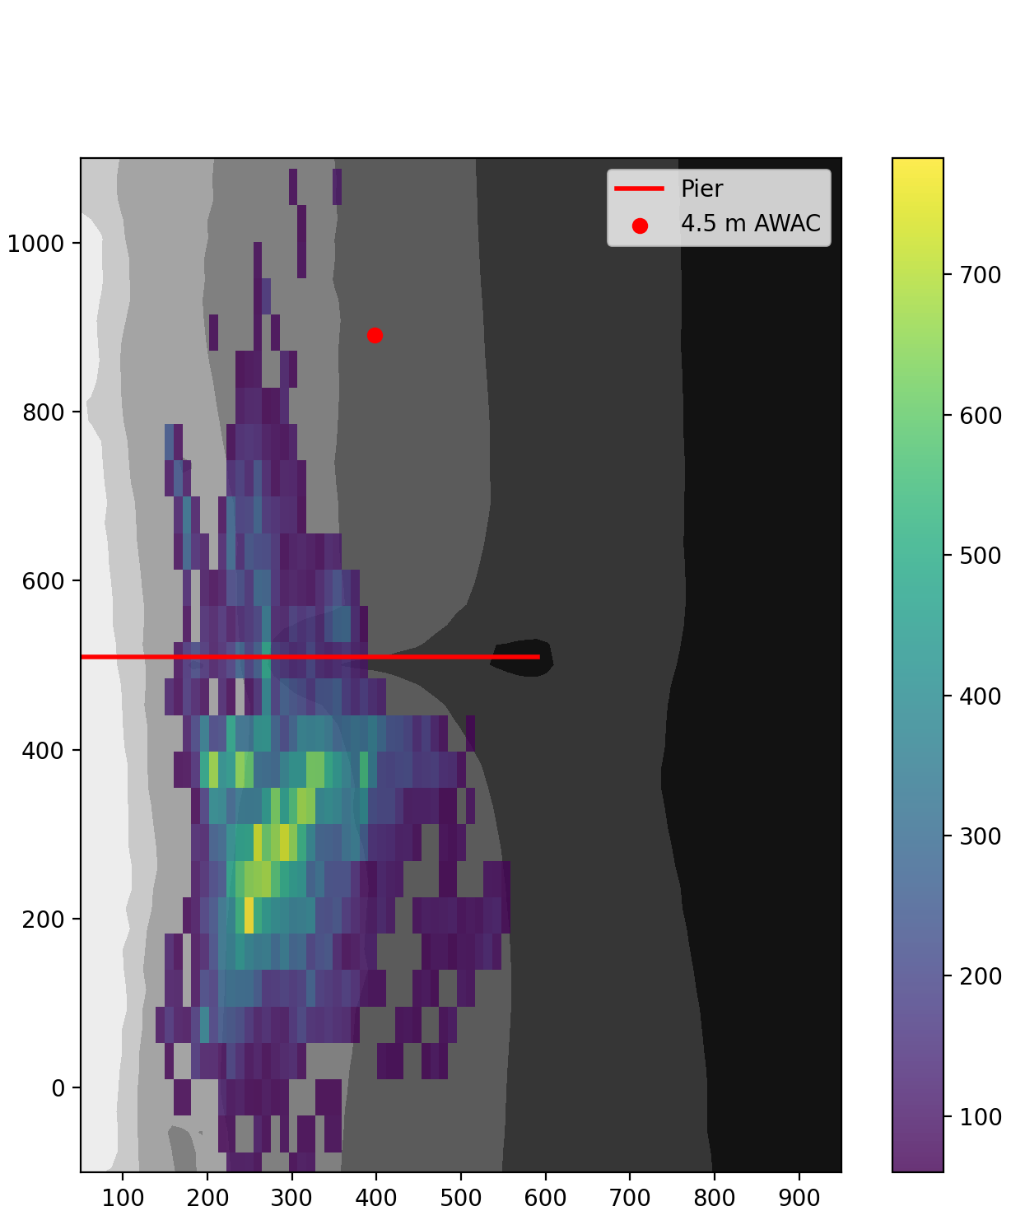
Figure 9 - Density of Waves Measured
-4 meters
-6 meters
-8 meters
Along Shore Distance [m]
Number of Wave Realizations
Cross Shore Distance [m]
Notes:
Move to after the figures on the next page

Slide 10
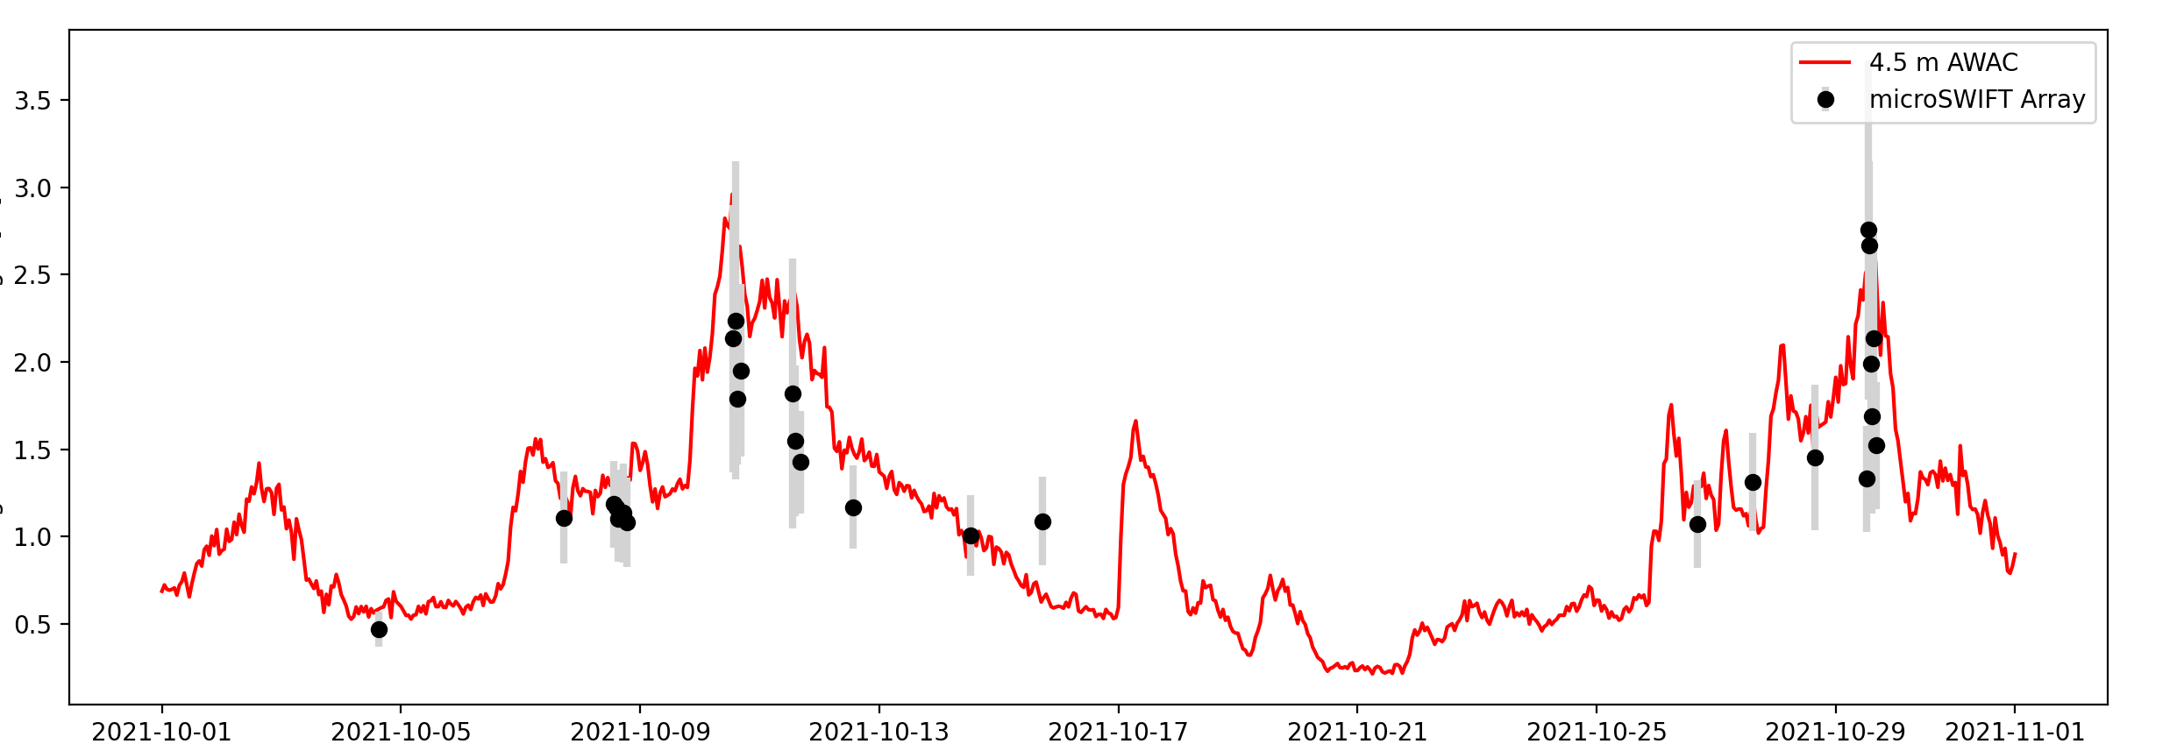
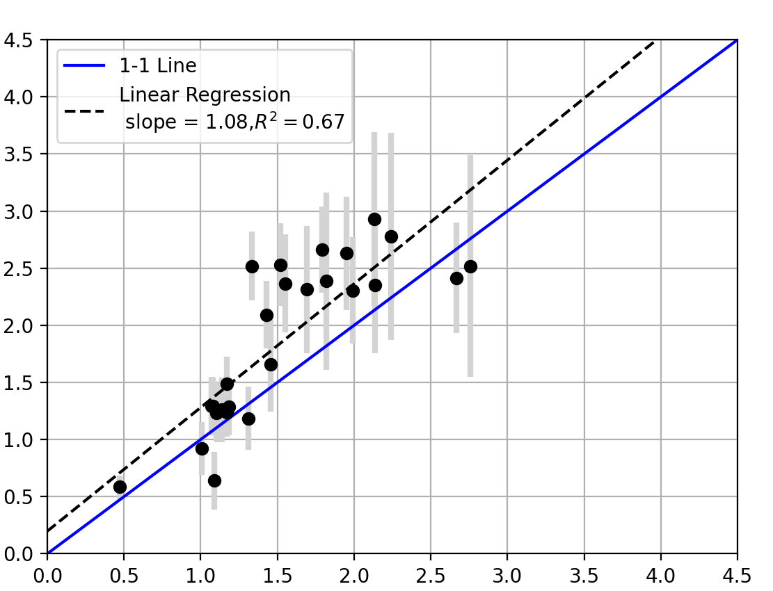
Figure 10 - Comparison of only waves 4-5 meters (Updated with higher despiking threshold)
(a)
(a)
Significant Wave Height [m]
Time [UTC]
(b)
4.5 m AWAC Significant Wave Height [m]
microSWIFT Array Significant Wave Height [m]
Notes:
Make it clear you are talking about bathymetry with the 4-5 meters title. I assumed wave height.

Slide 11
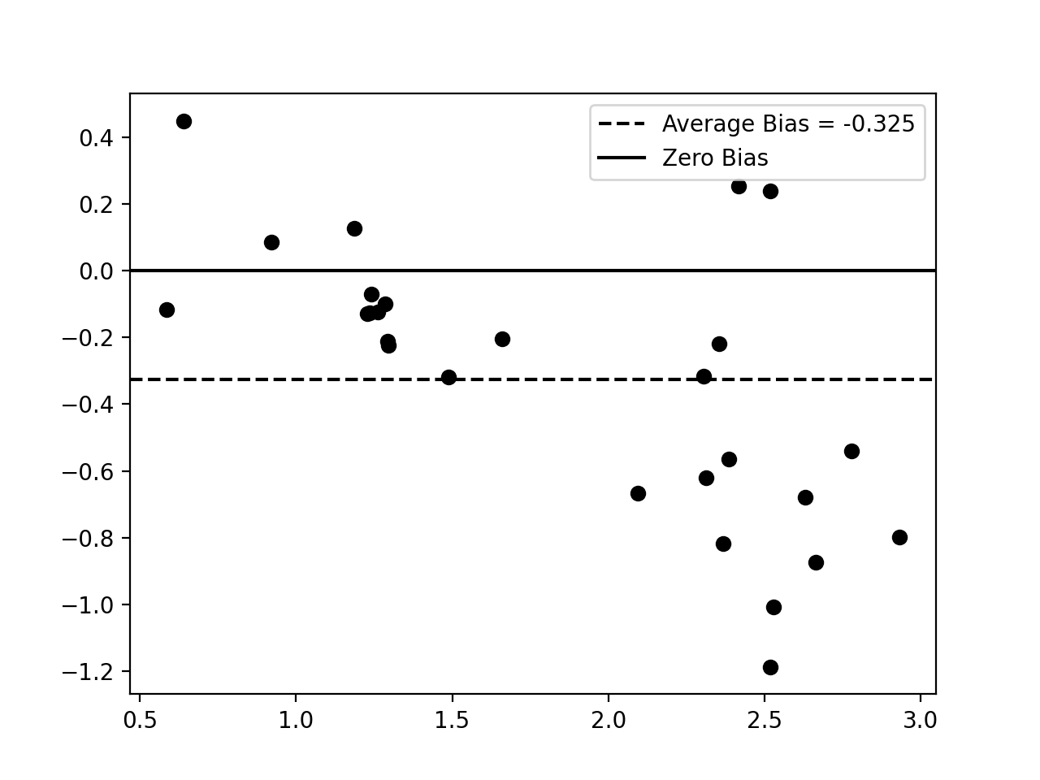
Significant Wave Height Bias [m]
4.5 m AWAC Significant Wave Height [m]

Slide 12
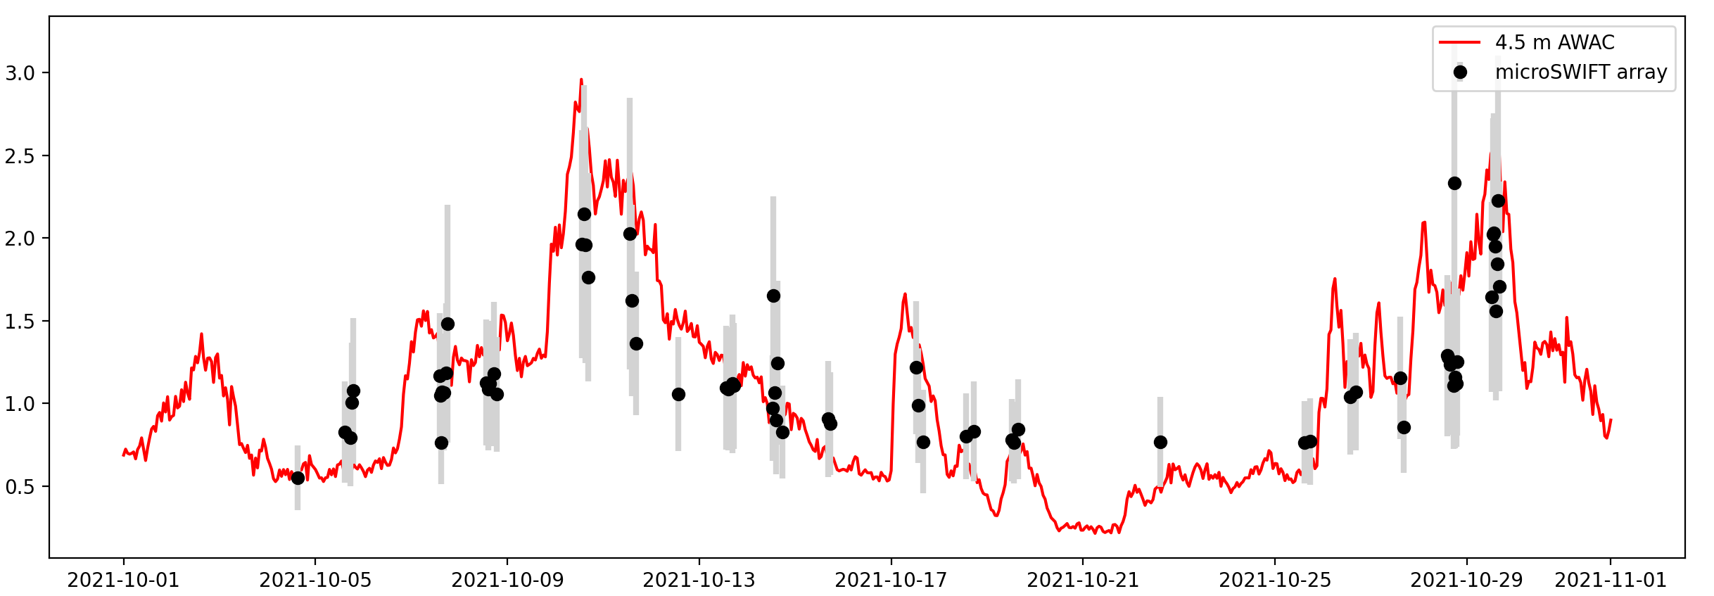
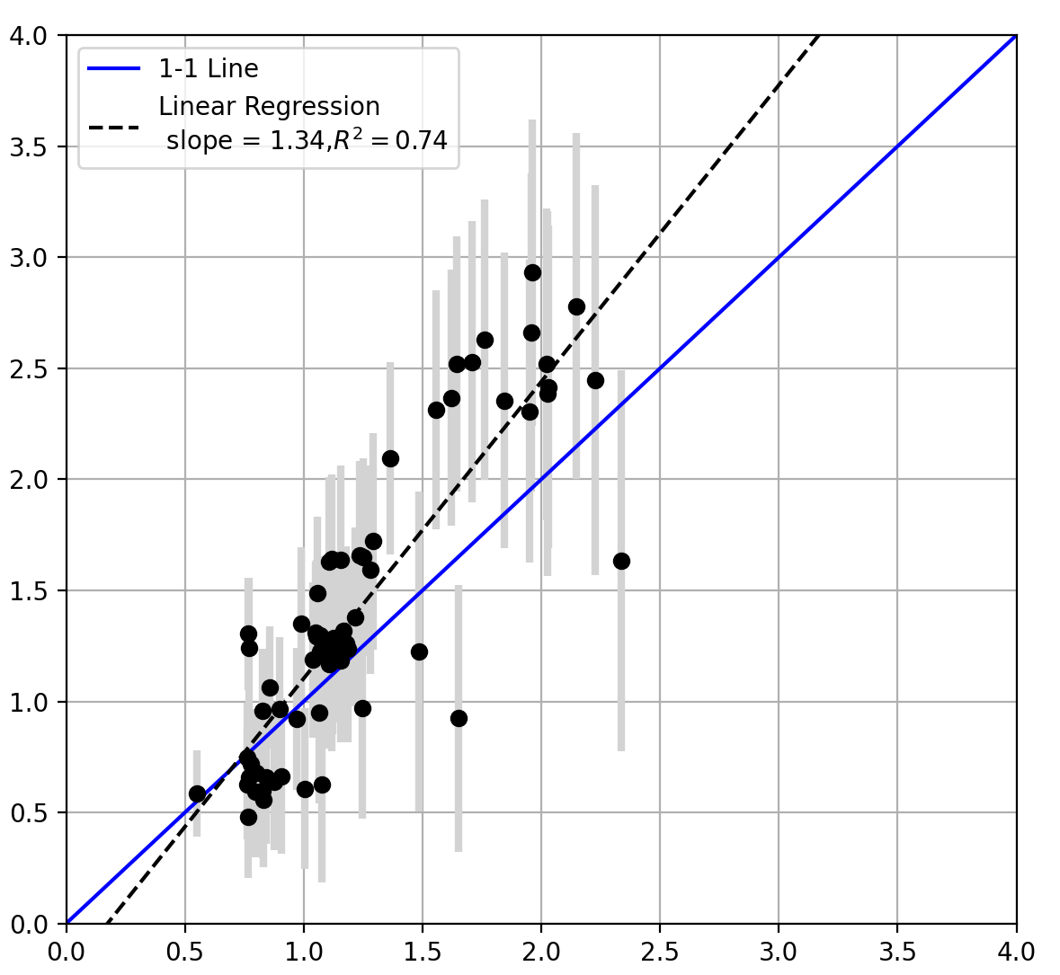
Figure 10 – Comparison of All waves in all depths
(a)
Significant Wave Height [m]
Time [UTC]
(b)
4.5 m AWAC Significant Wave Height [m]
microSWIFT Array Significant Wave Height [m]

Slide 13
